Slide 1
Codecademy Capstone
By: Korrin Perry

Slide 2
Table of Contents
Get familiar with CoolTShirts
What is the user journey?
Optimize the campaign budget

Slide 3
Get familiar with CoolTShirts

Slide 4
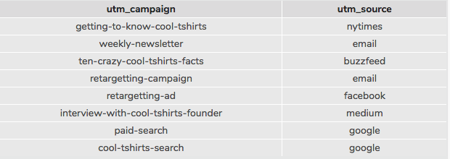
Get familiar with the company
UTM parameters are used by websites to capture information about what attributed to website traffic. UTM_campaign identifies the specific ad or email blast as compared to UTM_source identifies which touchpoint sent the traffic (e.g. google, email, facebook, etc.). The query resulted in 8 distinct campaigns that CoolTShirts uses and 6 distinct sources.
Code:
SELECT COUNT(DISTINCT utm_campaign)
FROM page_visits;
SELECT COUNT(DISTINCT utm_source)
FROM page_visits;
SELECT DISTINCT utm_campaign, utm_source
FROM page_visits;
Notes:
How many campaigns and sources does CoolTShirts use and how are they related? Be sure to explain the difference between utm_campaign and utm_source.

Slide 5
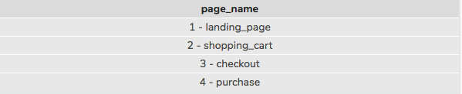
Get familiar with the company
Code:
SELECT DISTINCT page_name
FROM page_visits;
There are 4 distinct pages on the CoolTShirts website. These were identified using the page_visits table →
Notes:
What pages are on their website?

Slide 6
What is the user journey?

Slide 7
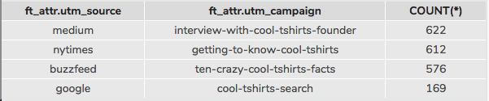
What is the user journey?
Code:
WITH first_touch AS (SELECT user_id,
MIN(timestamp) as first_touch_at
FROM page_visits
GROUP BY user_id),
ft_attr AS (
SELECT ft.user_id,
ft.first_touch_at,
pv.utm_source,
pv.utm_campaign
FROM first_touch ft
JOIN page_visits pv
ON ft.user_id = pv.user_id
AND ft.first_touch_at = pv.timestamp
)
SELECT ft_attr.utm_source,
ft_attr.utm_campaign,
COUNT(*)
FROM ft_attr
GROUP BY 1, 2
ORDER BY 3 DESC;
First Touch Attribution
In descending order, the count of first touches is as follows:
This tells us that the “interview-with-cool-tshirts-founder” was the most successful campaign at attracting people and the “cool-tshirts-search” on google was the least successful campaign,
Notes:
How many first touches is each campaign responsible for?

Slide 8
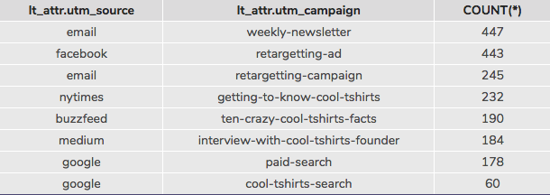
What is the user journey?
Code:
WITH last_touch AS (SELECT user_id,
MAX(timestamp) as last_touch_at
FROM page_visits
GROUP BY user_id),
lt_attr AS (
SELECT lt.user_id,
lt.last_touch_at,
pv.utm_source,
pv.utm_campaign
FROM last_touch lt
JOIN page_visits pv
ON lt.user_id = pv.user_id
AND lt.last_touch_at = pv.timestamp
)
SELECT lt_attr.utm_source,
lt_attr.utm_campaign,
COUNT(*)
FROM lt_attr
GROUP BY 1, 2
ORDER BY 3 DESC;
Last Touch Attribution
In descending order, the count of last touches is as follows:
This tells us that the “weekly-newsletter” was most successful with “retargetting-ad” as a close second and “cool-tshirts-search” on google as least successful
Notes:
How many last touches is each campaign responsible for?

Slide 9
What is the user journey?
Code:
SELECT COUNT(DISTINCT user_id)
FROM page_visits
WHERE page_name = '4 - purchase';
There were 361 distinct user_id’s for visitors that made a purchase on CoolTShirts.com
Notes:
How many visitors make a purchase?
How many last touches on the purchase page is each campaign responsible for?

Slide 10
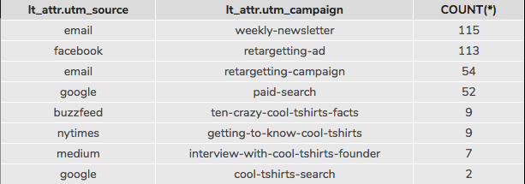
What is the user journey?
Code:
WITH last_touch AS (SELECT user_id,
MAX(timestamp) as last_touch_at
FROM page_visits
WHERE page_name = '4 - purchase'
GROUP BY user_id),
Using the previous last-touch query but adding a WHERE statement, the counts were as followed on the purchase page:
Notes:
How many visitors make a purchase?
How many last touches on the purchase page is each campaign responsible for?

Slide 11
What is the user journey?
The typical user journey starts from an ad that the user might see on a website as compared to a general web search. For example, overwhelmingly, most first touches came from article websites such as Medium, NYTimes, and Buzzfeed (in that order) compared to a Google search. By looking at the user’s last-touch attribution, since it is a good way of knowing how visitors are drawn back to the website for a final purchase, what is attracting user’s back to most likely make a purchase is the weekly newsletters from CoolTShirts and retargeting ads that are seen on Facebook.
Notes:
What is the typical user journey?

Slide 12
Optimize the campaign budget

Slide 13
Optimize the campaign budget
CoolTShirts should re-invest in:
Weekly Newsletter through email
Retargeting-Ad on Facebook
Interview with CoolTShirts Founder on Medium
Getting to Know CoolTShirts on NYTimes
Ten Crazy CoolTShirts Facts
These campaigns are suggested because the Newsletter and Retargeting Ad generated the highest number of last-touch attributions in conjunction with the articles on Medium, NYTimes, and Buzzfeed that generated the highest number of first-touch attributions out of all the campaigns previously run.
Notes:
CoolTShirts can re-invest in 5 campaigns. Which should they pick and why?

